Slide 1
Need Finding
Emmanuel Respicio
Jhed Ross Bunagan

Slide 2
Observation

Slide 3
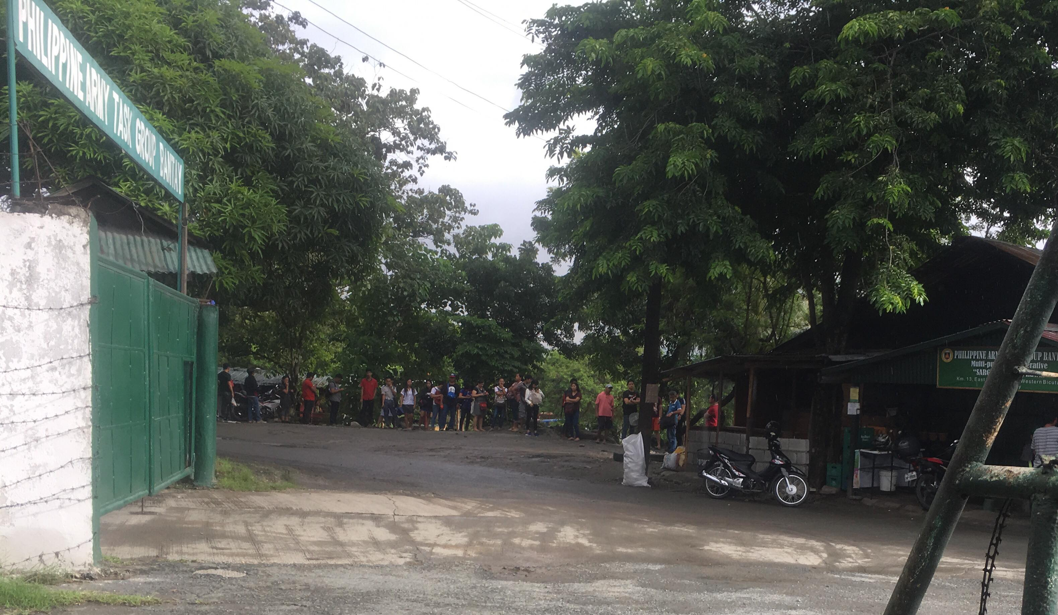
The researcher decided to observe the terminal in the service road (route FTI to Moa vice versa). Also, on how does the people got a ride on time.
Commuters does not have any assurance when they can have a ride.

Slide 4
User Needs

Slide 5
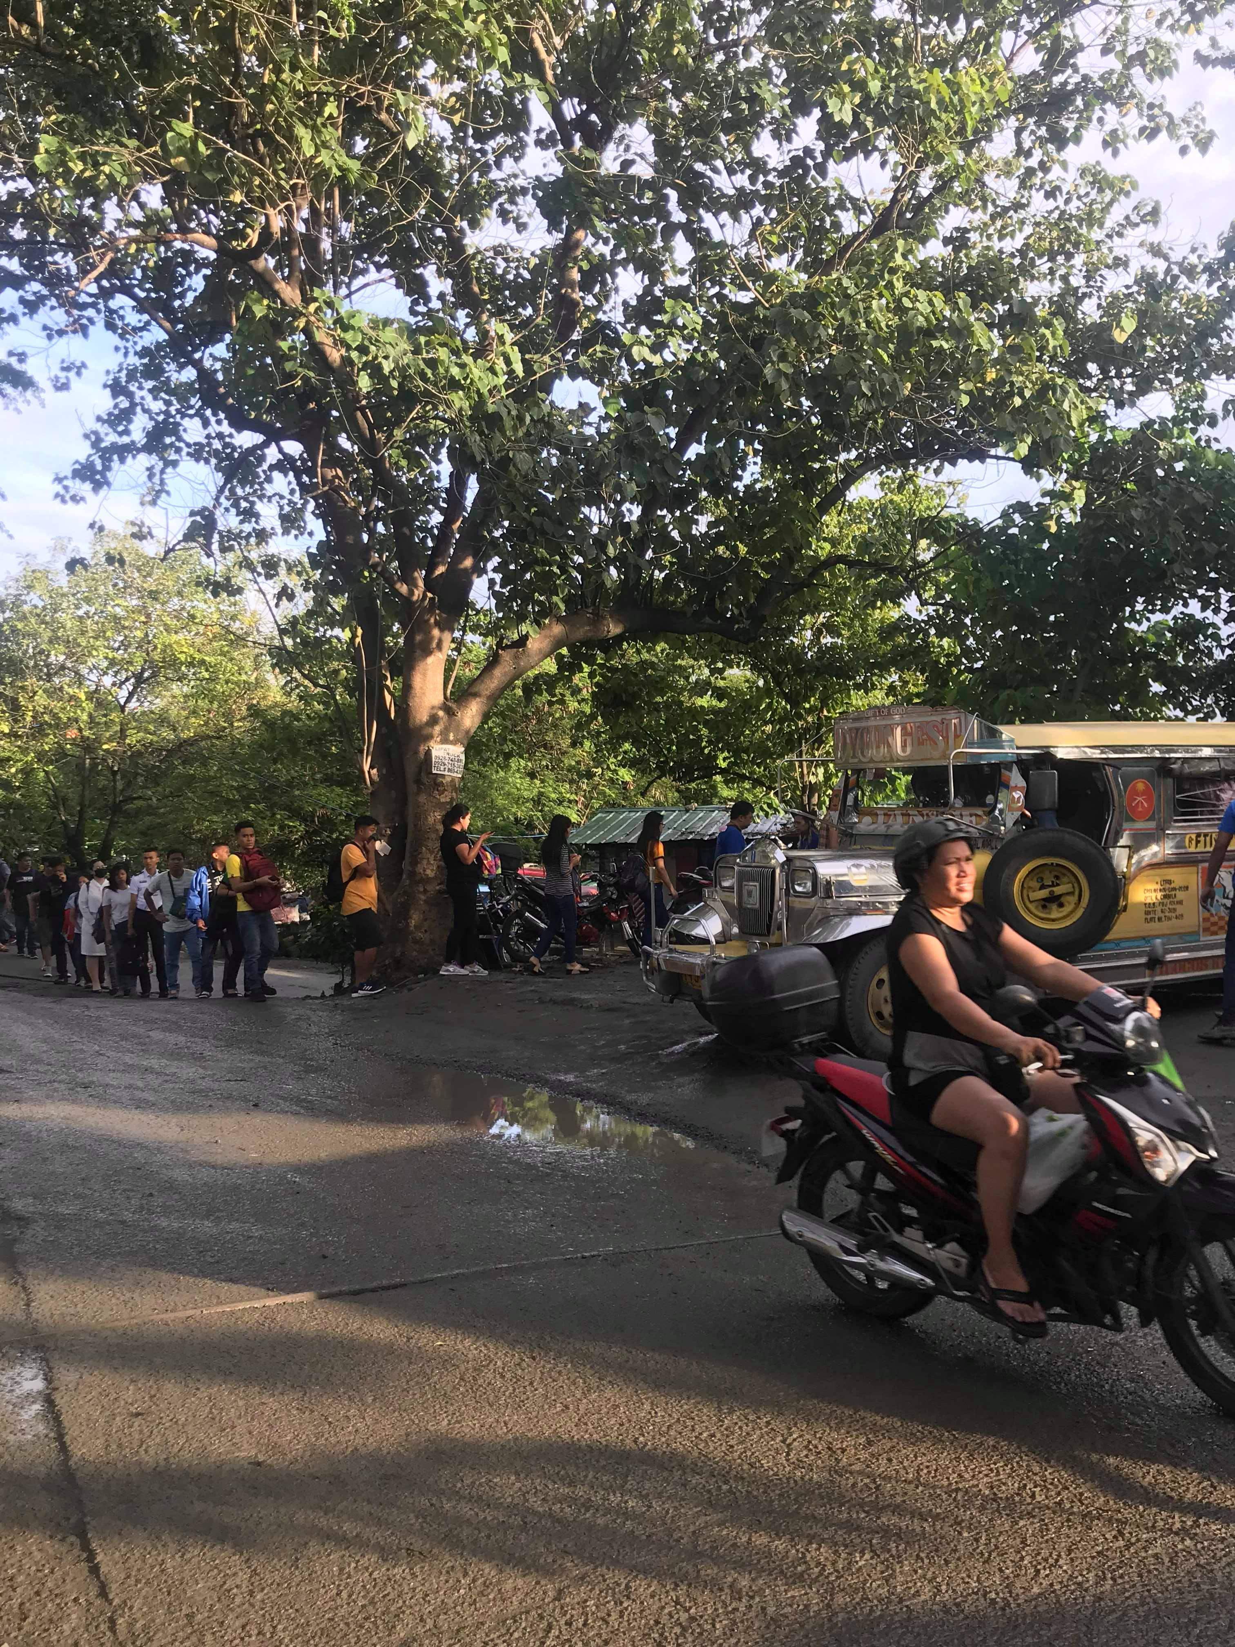
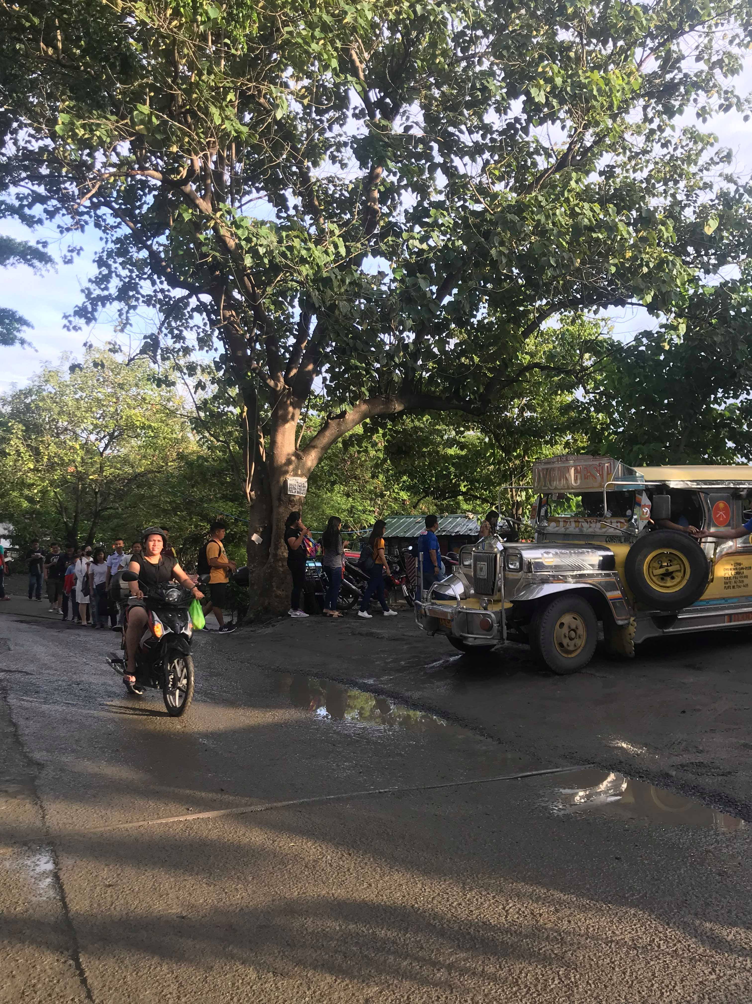
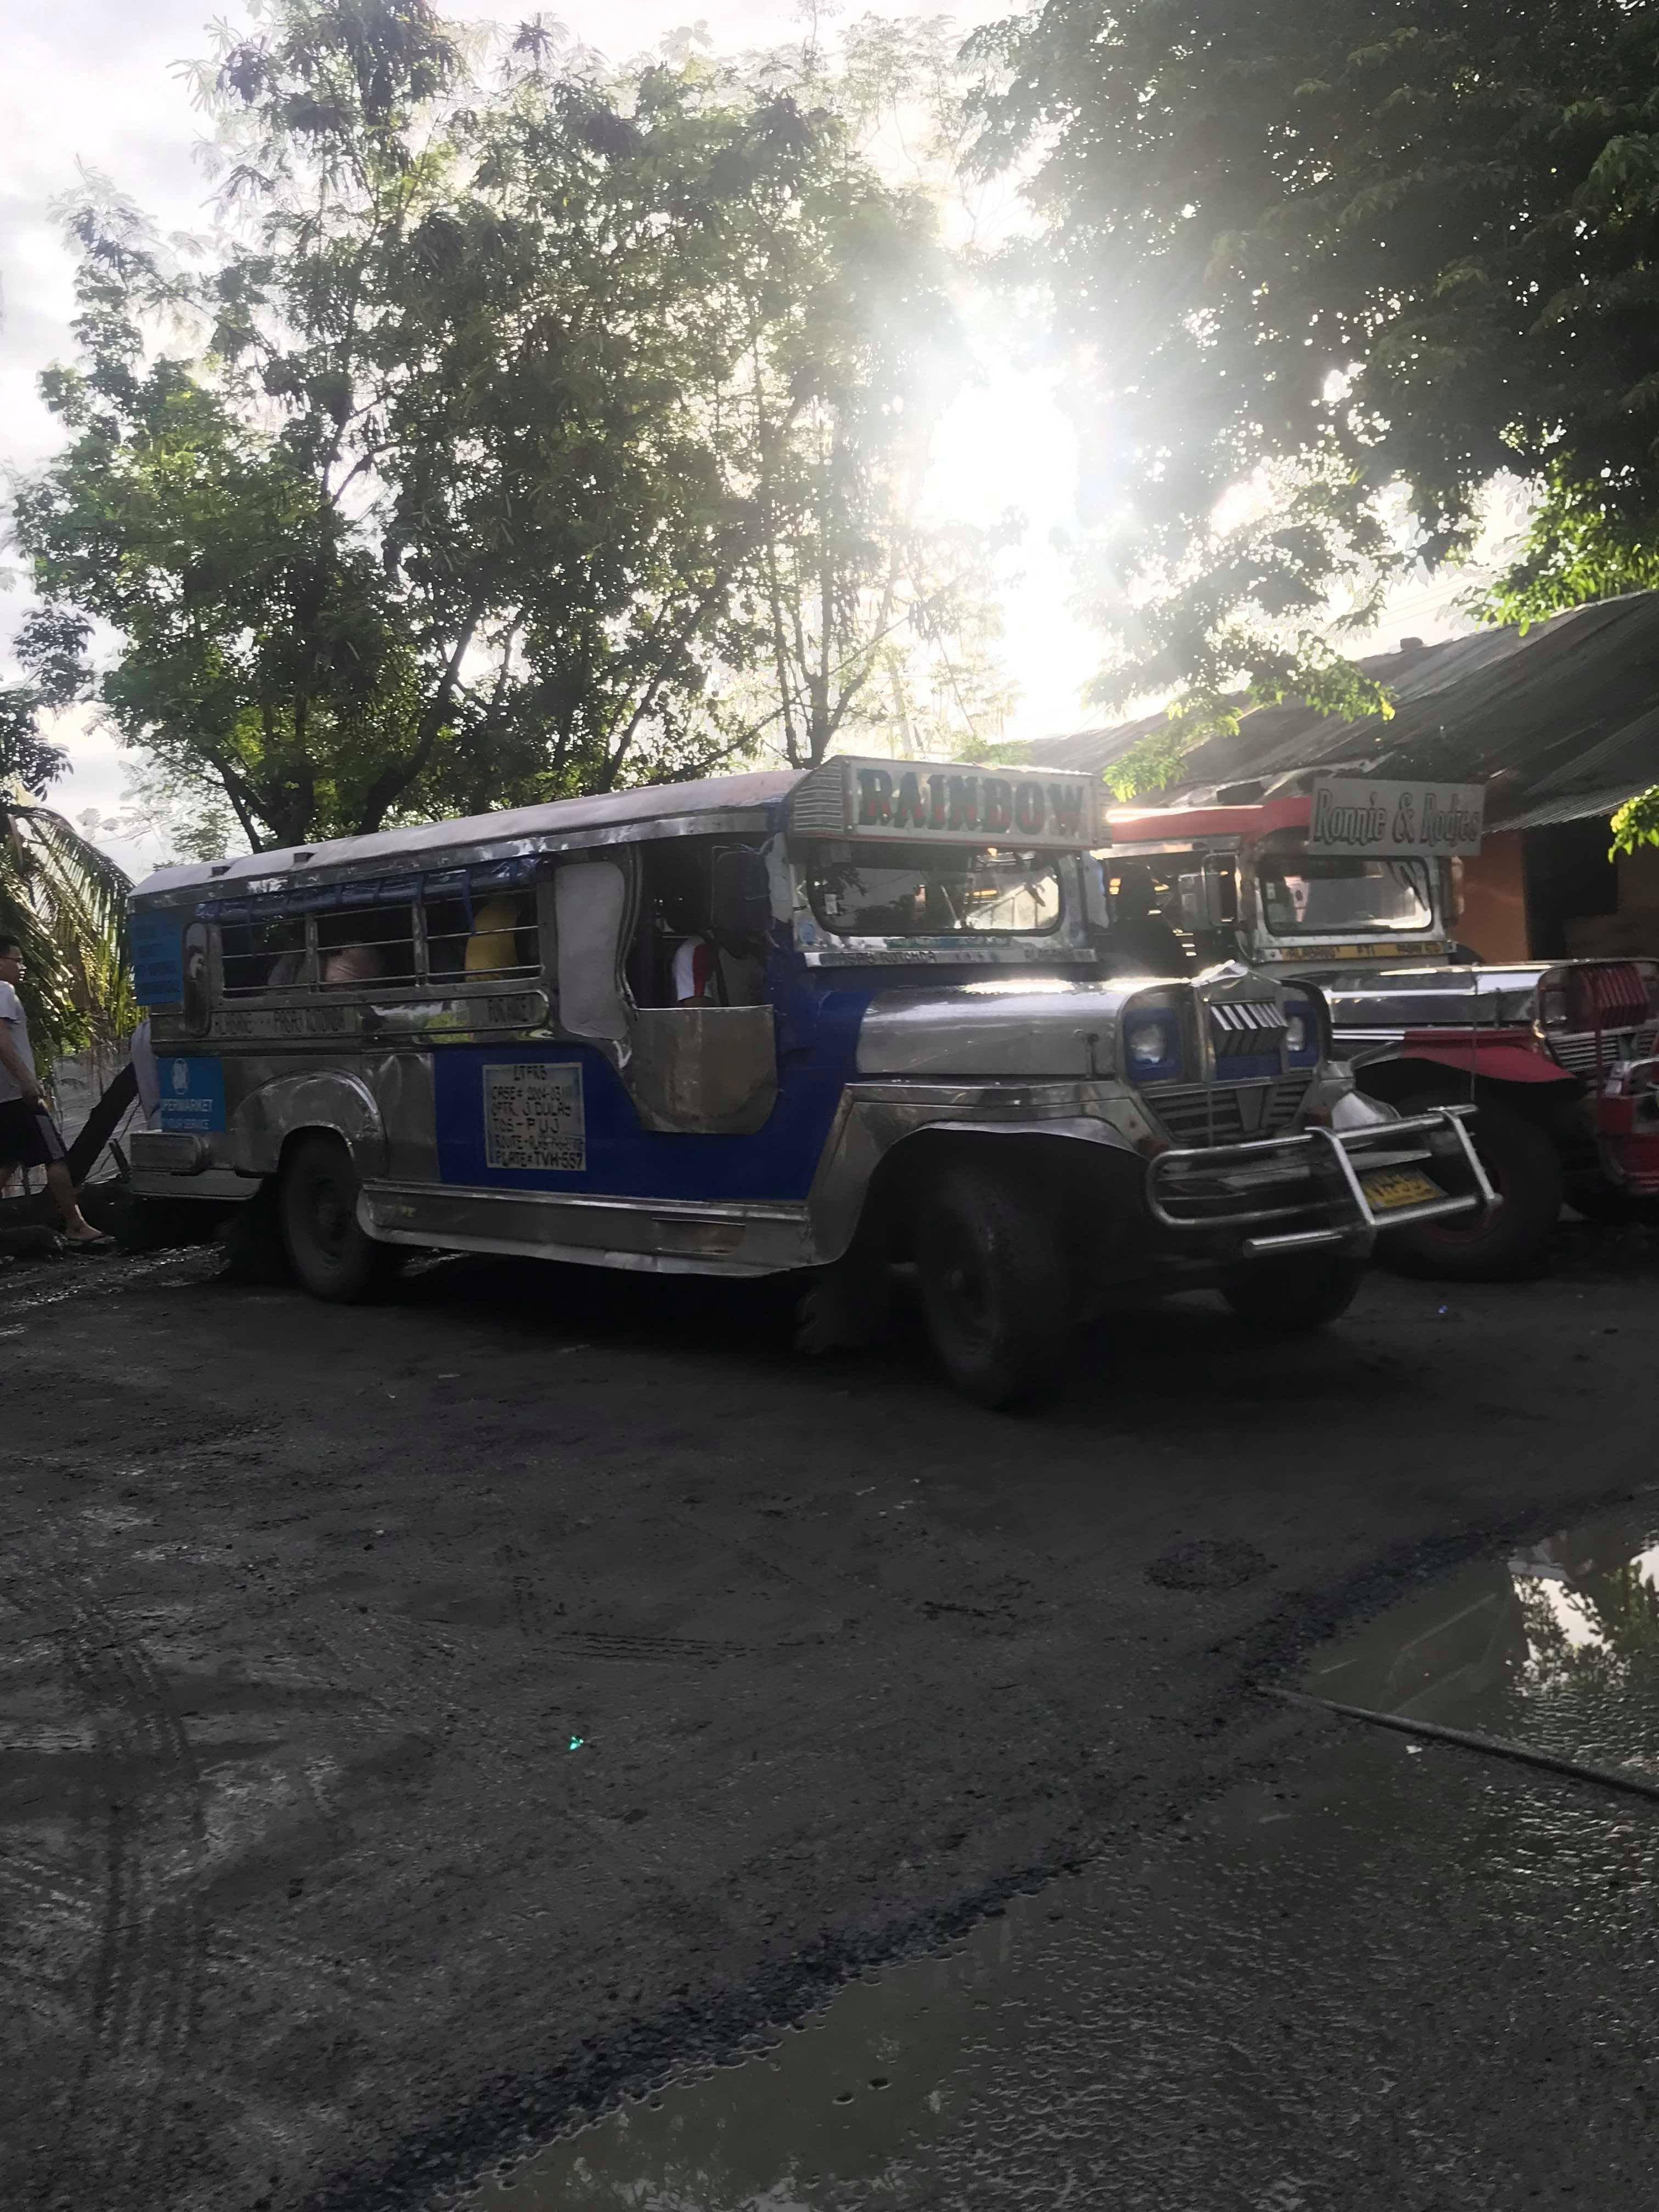
They need to have assurance in what time they can get a ride.
Commuters need to get an efficient ride.
Jeepney commuter need to get a ride with a short period of time. So that they can manage their time as well.

Slide 6
Point of View

Slide 7
Jeepney tracking, so that the commuter could know when they can have a ride.
Jeepney app for reservation of slot. (Grab jeep)
Local government should take over in each terminals, in order to be organized.

Slide 8
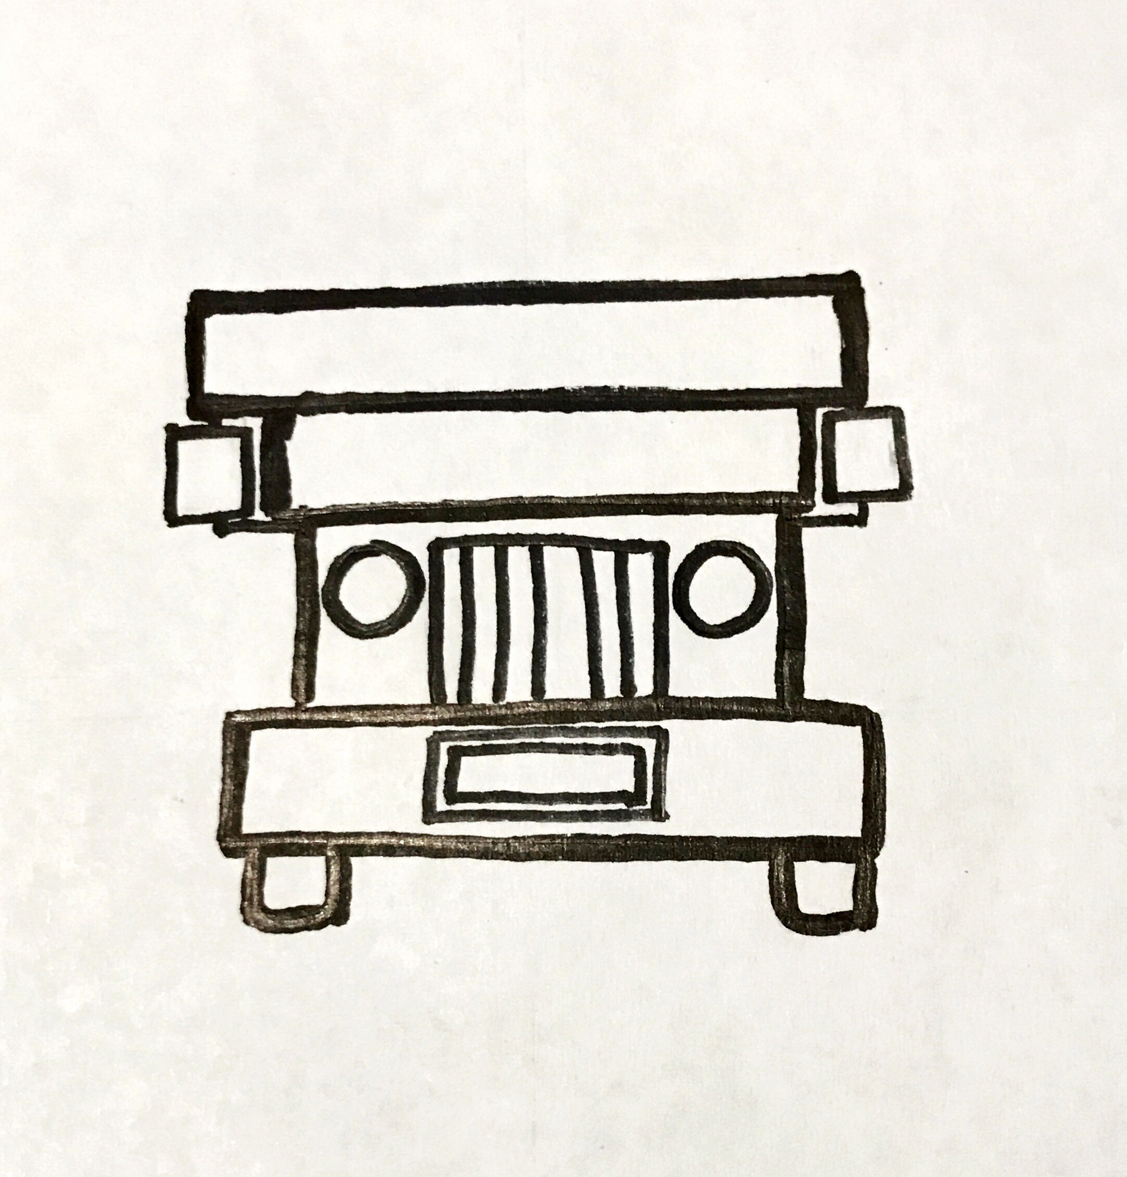
Storyboard

Slide 9
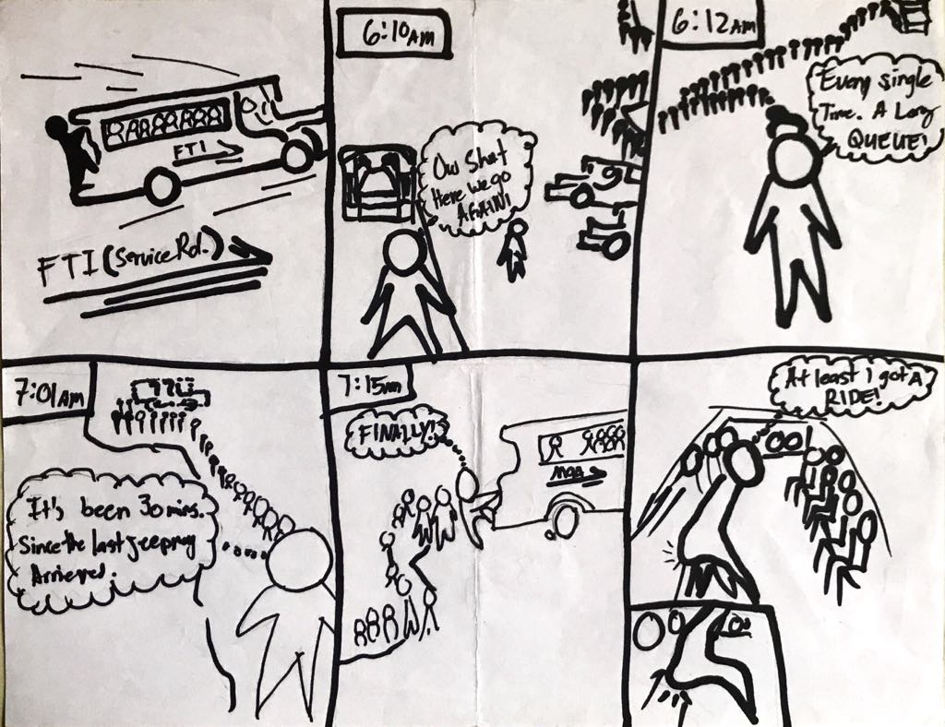

Slide 10
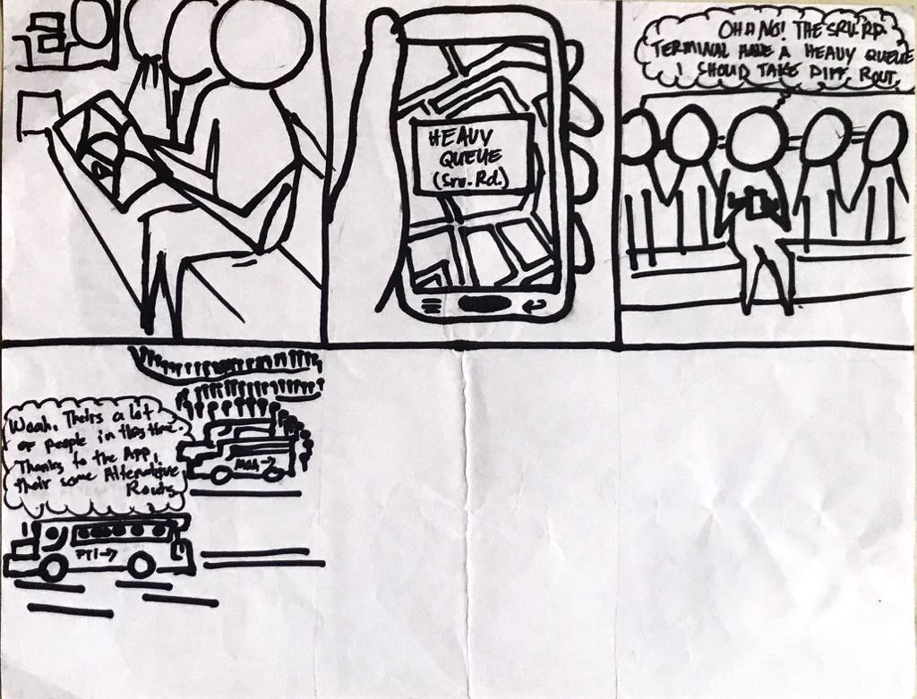

Slide 11
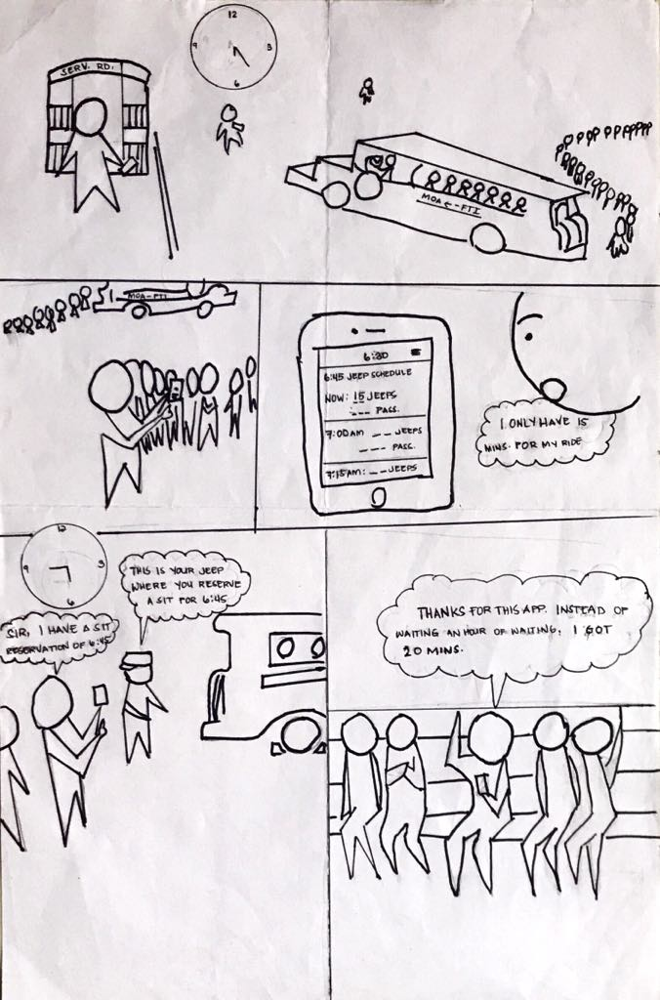

Slide 12
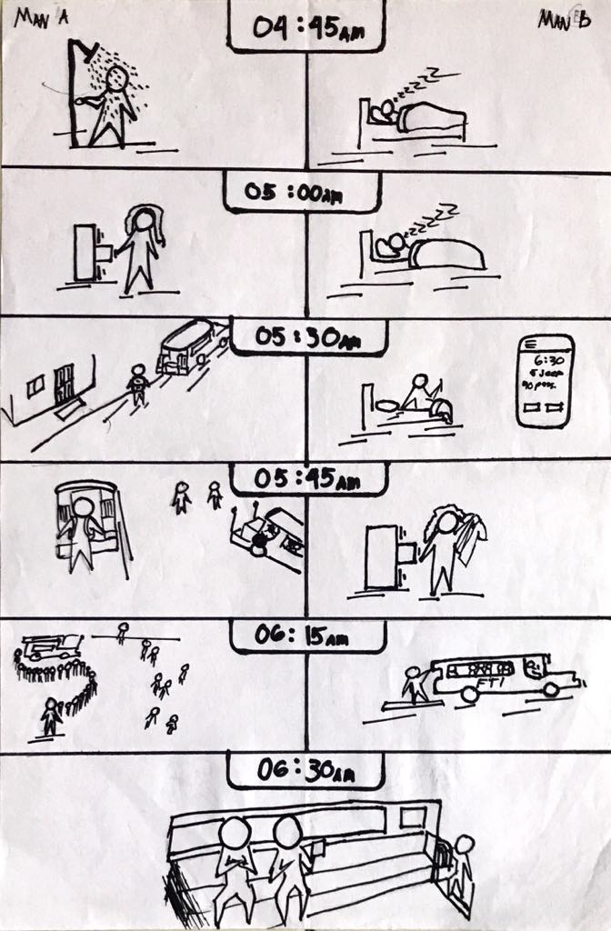

Slide 13
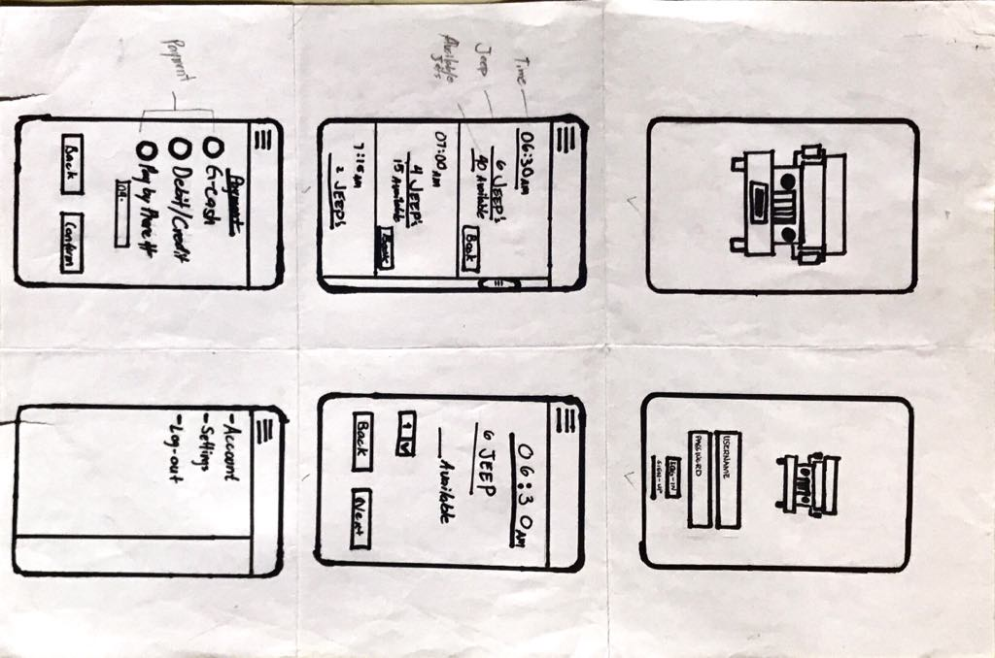
Place your screenshot here
Paper Prototype

Slide 14
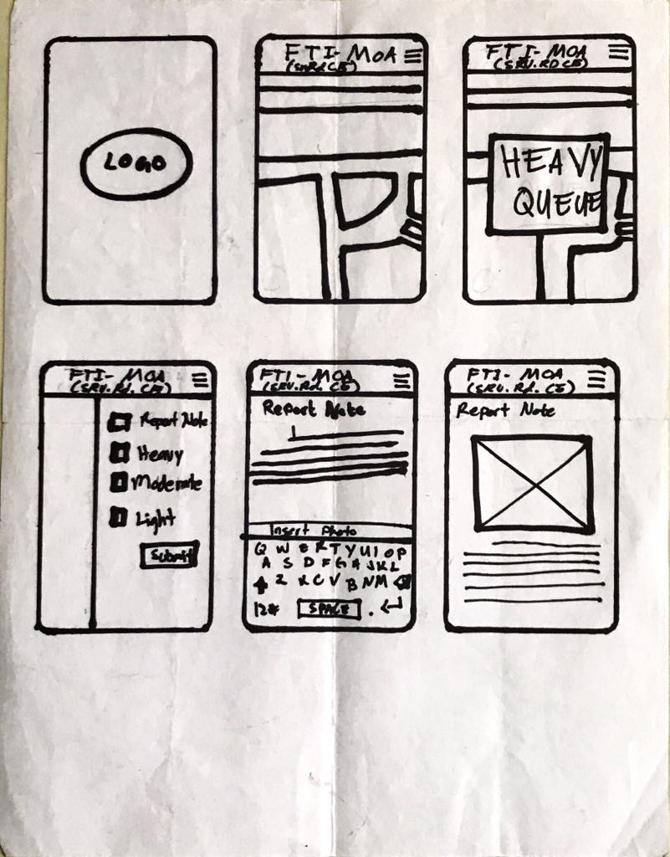

Slide 16
OUR PROCESS IS EASY
Book
Pay
Ride

